Slide 1
Used Car price Analysis

Slide 2
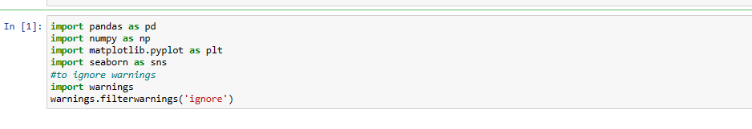
Step 1: Importing python libraries
Importing libraries to plot graphs

Slide 3
Step 2: reading dataset
In this article, the data to predict Used car price is being used as an example.
In this dataset, we are trying to analyze the used car’s price and how EDA focuses on identifying the factors influencing the car price.
We have stored the data in the Data Frame as data.
Below is the command used in python to read csv file containing data named ‘used_cars_data.csv’

Slide 4
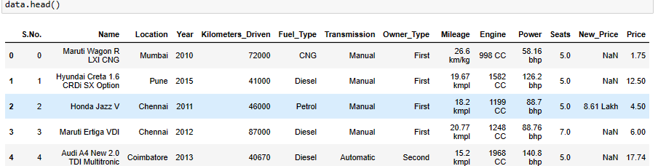
Analysing the Data
head() command is used in python to get the first 5 rows of the data to analyze the columns and data. The main goal of data understanding is to gain general insights about the data, which covers the number of rows and columns, values in the data, datatypes, and Missing values in the dataset.

Slide 5
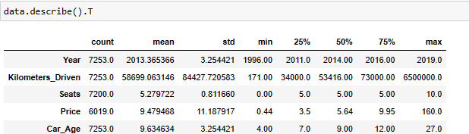
Statistics summary
The information gives a quick and simple description of the data . Can include Count, Mean, Standard Deviation, median, mode, minimum value, maximum value, range, standard deviation, etc.
Insights: Years range from 1996- 2019 and has a high in a range which shows used cars contain both latest models and old model cars.
On average of Kilometers-driven in Used cars are ~58k KM. The range shows a huge difference between min is only 171km and max as max values show 650000 KM shows the evidence of an outlier ✔. This record can be removed.
Min value of Mileage shows no cars is sold with 0 mileage. This sounds like a data entry issue. It looks like Engine and Power have outliers, and the data is right-skewed.
The average number of seats in a car is 5. car seat is an important feature in price contribution.
The max price of a used car is 160k which is quite weird, such a high price for used cars. There may be an outlier or data entry issue.
describe(include=’all’) provides a statistics summary of all data, include object, category etc.

Slide 6
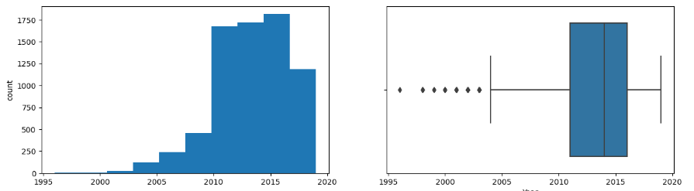
Univariate analysis
Univariate on Year Column Insights:
As expected in Year Column There are some outliers or we can say old models of cars and the graph is right skewed along new models
Most of the models in the data are between 2010 and 2015

Slide 7
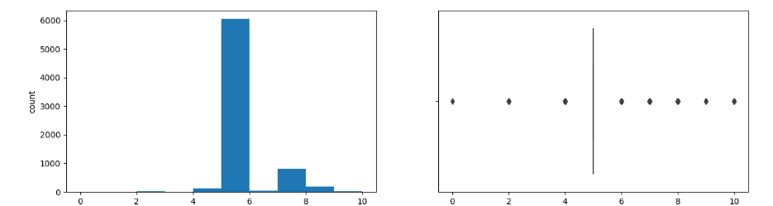
Univariate analysis on Car Seats Column
INSIGHTS:
MOST OF THE CARS HAS 5 SEATS.

Slide 8
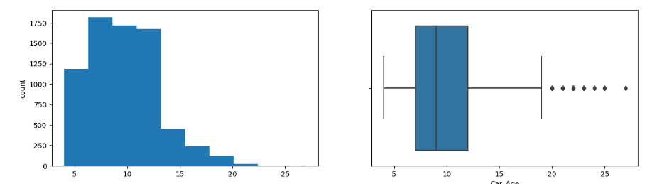
Univariate analysis on car age column
Insights :
Car Age column is left skewed as expected as most of the cars are 8 to 13 years old
There are some outliers that is cars older than 20 years

Slide 9
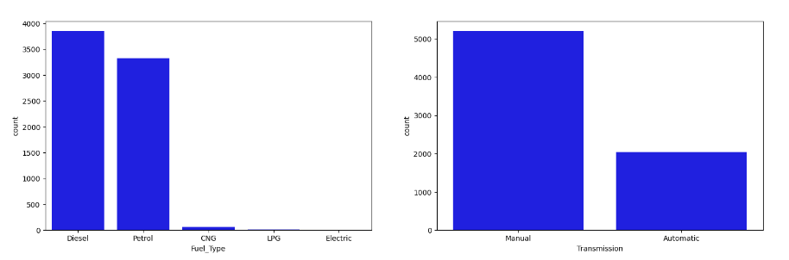
Transmission and fuel type insights
~53% of cars have fuel type as Diesel this shows diesel cars provide higher performance while very few are CNG
~72% of cars have manual transmission

Slide 10
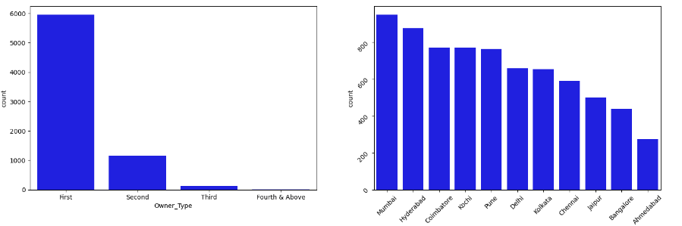
Location and owner type column insights
Mumbai has the highest number of cars available for purchase, followed by Hyderabad and Coimbatore while Ahmedabad has lowest
~82 % of cars are First owned cars. This shows most of the buyers prefer to purchase first-owner cars.

Slide 11
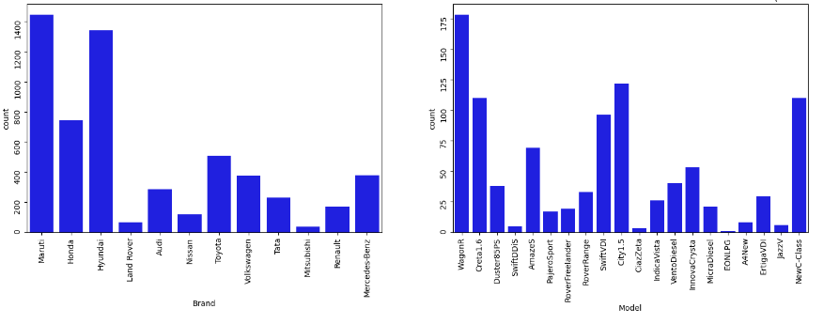
Brand and model column insights
~20% of cars belong to the brand Maruti followed by 19% of cars belonging to Hyundai while Mitsubishi cars for purchase are least.
WagonR ranks first among all models which are available for purchase While EONLPG is the least available for purchase

Slide 12
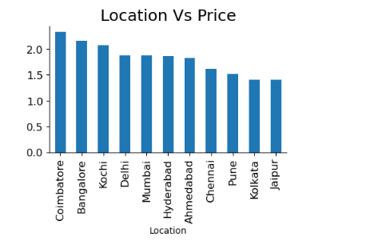
Bivariate analysis: Location vs. price
Now, let’s move ahead with bivariate analysis. Bivariate Analysis helps to understand how variables are related to each other and the relationship between dependent and independent variables present in the dataset.
The price of cars is high in Coimbatore and less price in Kolkata and Jaipur whilw least in Kolkata and Jaipur.

Slide 13
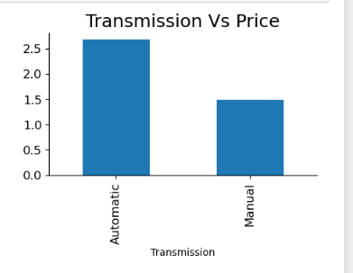
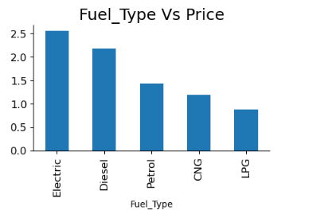
Bivariate analysis :Transmission vs. price, Fuel type vs. price
Automatic cars have more price than manual cars.
Diesel and Electric cars have almost the same price, which is maximum, and LPG cars have the lowest price

Slide 14
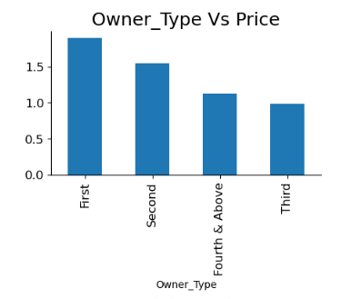
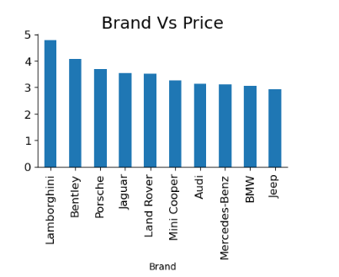
Bivariate analysis :owner type vs. price, brand vs price
First-owner cars are higher in price, followed by a second the third owner’s price is lesser than the Fourth and above
Lamborghini brand is the highest in price while

Slide 15
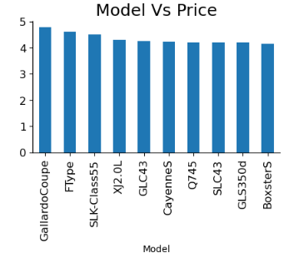
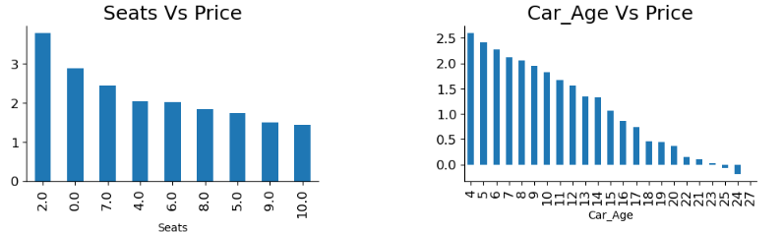
Model vs. price, seats vs price, car age vs. price
Gallardo coupe Model is the highest in price
2 Seater has the highest price followed by 7 Seater
The latest model cars are high in price as expected.

Slide 16
Conclusion
Data Analysis helps to find the basic structure of the dataset.
Dropped columns that are not adding value to our analysis.
Performed Feature Engineering by adding some columns which contribute to our analysis.
Data Transformations have been used to normalize the columns.
We used different visualizations for EDA like Univariate, Bi-Variate Analysis
Through EDA, we got useful insights, and below are the factors influencing the price of the car and a few takeaways:
Most of the customers prefer 2 Seat cars hence the price of the 2-seat cars is higher than other cars.
The price of the car decreases as the Age of the car increases.
Customers prefer to purchase the First owner rather than the Second or Third.
Due to increased Fuel price, the customer prefers to purchase an Electric vehicle.
Automatic Transmission is easier than Manual.
This way, we perform EDA on the datasets to explore the data and extract all possible insights, which can help in model building and better decision making.
Reference :https://www.analyticsvidhya.com/

